Slide 1
Collections And Input/Output
CS 3331
Section 8.2
Chapter 8 of Core Java SE 9 (ebook)

Slide 2
Outline
Collections
Collection interfaces
Collection classes
Iterators
Ordering
Streams (Java 8)
Input/output

Slide 3
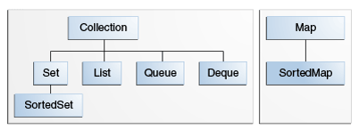
Collections in Java
Major types of collections
Sets, bags, lists, maps
Defined in java.util and java.util.concurrent
Generic since Java 5
Interfaces of collections
Q: Key properties?
Math models?

Slide 4
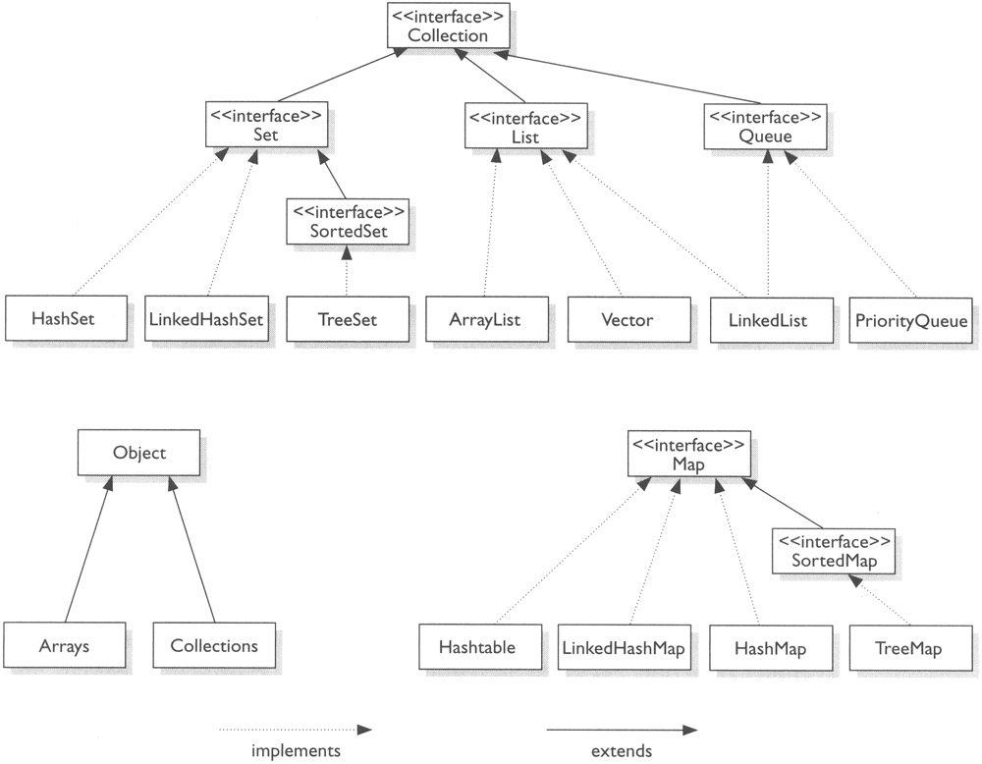
Collection & Map
https://www.studytonight.com/java/collection-framework.php

Slide 5
Collection Interface
Method Description
add(o) Add a new element
addAll(c) Add all elements of c
remove(o) Remove an element
removeAll(c) Remove all elements found in c
retainAll(c) Retain only elements found in c
clear() Remove all elements
contains(o) Membership testing
containsAll(c) Membership testing
isEmpty() Whether it is empty
size() The number of contained elements
iterator() Return an iterator
forEach(a) Perform an action on each (Java 8)

Slide 6
Set Interface
Method Description
add(o) Add an element if not already present
addAll(c) Add each elements of c if not present

Slide 7
Exercise
Define a set-intersection method.
public static <E> Set<E> union(Set<E> x, Set<E> y) {
Set<E> r = new HashSet<>(); // to be discussed later.
r.addAll(x);
r.addAll(y);
return r;
}
public static <E> Set intersection(Set<E> x, Set<E> y) {
// WRITE YOUR CODE HERE!
}

Slide 8
List Interface
overloaded
Method Description
add(i, o) Insert o at the i-th position
add(o) Append o at the end
addAll(i, c) Insert all elements of c starting at the i-th position
addAll(c) Append all elements of c at the end
remove(i) Remove i-th element
remove(o) Remove the first occurrence of o
set(i, o) Replace i-th element with o
get(i) Return i-th element
indexOf(o) Return the index of the first occurrence of o
lastIndexOf(o) Return the index of the last occurrence of o
listIterator() Return a list iterator
listIterator(i) Return a list iterator for the sublist starting from i
subList(i, j) Retrun a sublist between index i and j

Slide 9
Map Interface
Method Description
put(k,v) Associate v with k
remove(k) Remove the mapping for k
clear() Remove all mappings
get(k) The value associated with k
containsKey(k) Whether contains a mapping for k
containsValue(v) Whether contains a mapping to v
size() The number of pairs
isEmpty() Whether it is empty
….

Slide 10
Map Interface (Cont.)
Method Description
entrySet() Set of key-value pairs, Map.Entry<K,V>
keySet() Set of keys
values() The collection of values
keySet()
values()
k1
k2
k3
.
.
.
kn
v1
v2
v3
.
.
.
vn
entrySet()

Slide 11
Outline
Collections
Collection interfaces
Collection classes
Iterators
Ordering
Streams (Java 8)
Input/output

Slide 12
Implementation of Collections
Why different implementations?
Bounded vs. unbounded
Time and space complexity of operations
Sets
Class Interface Description
HashSet Set Hash table
LinkedHashSet Set Hash table & DLL
TreeSet SortedSet Balanced binary tree

Slide 13
Implementation (Cont.)
Lists
Class Interface Description
ArrayList List Resizable array
LinkedList List Doubly linked list
Vector List Legacy of JDK 1.0

Slide 14
Implementation (Cont.)
Maps
Class Interface Description
HashMap Map Hash table
IdentityHashMap Map Hash table with identity comparison
LinkedHashMap Map Hash table and DLL
TreeMap SortedMap Balanced binary tree
Hashtable Map Legacy of JDK 1.0

Slide 15
Example
Counting word frequency
public static void frequence(String[] words) {
Map<String, Integer> map = new LinkedHashMap<>();
for (String w: words) {
if (!map.containsKey(w)) {
map.put(w, 1);
} else {
map.put(w, 1 + map.get(w));
}
}
map.entrySet().forEach(e -> System.out.println(e.getKey() + “:\t” + e.getValue());
}

Slide 16
Exercise
Write a method that counts distinctive words.
/** Return the number of different words in the given array. */
public static int numOfDifferentWords(String[] words) {
// WRITE YOUR CODE HERE
}

Slide 17
Iterators of Collections
Iterator
ListIterator (extends Iterator) - An iterator for lists that allows the programmer to traverse the list in either direction, modify the list during iteration, and obtain the iterator's current position in the list.
Method Description
add(o) Insert o in the current position
remove() Remove the last element
set(o) Replace the current element with o
hasNext() More element in the forward?
hasPrevious() More element in the reverse?
next() Return the next element
nextIndex() Return the next index
previous() Return the previous element
previousIndex() Return the previous index

Slide 18
Iterable (since Java 5)
Collection<E> Iterable<E>
Method Description
iterator() Return an iterator
forEach(a) Perform an action on each elem
(since Java 8 with “default” impl.)
// for-each statement (since Java 5)
Iterable<String> names = …;
for (String s: names) {
System.out.println(s);
}
// forEach method (since Java 8)
names.forEach(s -> System.out.println(s));
// or names.forEach(System.out::println) // method reference

Slide 19
Outline
Collections
Collection interfaces
Collection classes
Iterators
Ordering
Streams (Java 8)
Input/output

Slide 20
Group Work: Set Implementation
Work in group of two or three to write class ArraySet that implements
the Set interface. You should use an array to store the elements.
Method Description
add(o) Add a new element
addAll(c) Add all elements of c
remove(o) Remove an element
removeAll(c) Remove all elements found in c
retainAll(c) Retain only elements found in c
clear() Remove all elements
contains(o) Membership testing
containsAll(c) Membership testing
isEmpty() Whether it is empty
size() The number of elements
iterator() Return an iterator

Slide 21
Ordering and Sorting
Partial order
Binary relation that is transitive
Total order if a < b and b < a implies a = b
How to define order on objects?
Natural order by implementing the Comparable interface
Arbitrary order by comparators (classes implementing the Comparator interface)

Slide 22
Comparable Interface
public interface Comparable<T> {
int compareTo(T o);
}
Method compareTo:
Result < 0, if the receiver precedes o
Result = 0, if neither the receiver precedes o, nor o precedes the receiver
Result > 0, if o precedes the receiver
Properties (or constraints)
a.compareTo(b) > 0 implies that b.compareTo(a) < 0
a.compareTo(b) < 0 implies that b.compareTo(a) > 0
a.compareTo(b) = 0 implies that b.compareTo(a) = 0;
Consistent with the definition of equals, i.e.,
a.equals(b) is true iff a.compareTo(b) is 0

Slide 23
Exercise
Define a natural order for the Employee class based on the name.
public class Employee implements Comparable<Employee> {
private String name;
public int compareTo(Employee other) {
// YOUR CODE HERE …
}
}

Slide 24
Comparator Interface
public interface Comparator<T> {
int compare (T o1, T o2);
}
Method compare:
Result < 0, if o1 precedes o2
Result = 0, if neither o1 precedes o2, nor o2 precedes o1
Result > 0, if o2 precedes o1
Properties (or constraints)
c.compare(a,b) > 0 implies that c.compare(b,a) < 0
c.compare(a,b) < 0 implies that c.compare(b,a) > 0
c.compare(a,b) = 0 implies that c.compare(a,b) = 0;
Consistent with equals, i.e.,
c.compare(a,b) is 0 iff a.equals(b) and b.equals(a)

Slide 25
Exercise
Define a total ordering for the Employee class based on the salary.
public class Employee extends Comparable<Employee> {
public int salary() { /*… */ }
public int compareTo(Employee other) { /* … */ }
// other declarations …
}
public class SalaryComparator implements Comparator<Employee> {
public int compare(Employee e1, Employee e2) {
// YOUR CODE HERE …
}
}

Slide 26
Sorted Collections
Interfaces
SortedSet and SortedMap
Classes
TreeSet and TreeMap
Examples
SortedSet<Employee> s1 = new TreeSet<>(); // Q: sorted by what?
SortedSet<Employee> s2 = new TreeSet<>(new SalaryComparator());
SortedMap<String, Employee> m1 = new TreeMap<>();
SortedMap<Employee, Project> m2 =
new TreeMap<>(new SalaryComparator());

Slide 27
Collection & Map
https://www.studytonight.com/java/collection-framework.php

Slide 28
SortedSet Interface
Method Description
comparator() Return the comparator
first() Return the first (lowest) element
last() Return the last (highest) element
headSet(o) Return elements less than o
tailSet(o) Return elements greater than or equal to o
subSet(o1,o2) Return elements between o1 and o2

Slide 29
Exercise
Write a method that, given an array of Person objects, returns a sorted array of the argument array. Assume that the Person class has a natural order defined.
public static Person[] sort(Person[] persons) {
// YOUR CODE HERE …
}

Slide 30
SortedMap Interface
Method Description
comparator() Return the comparator
firstKey() Return the first (lowest) key
lastKey() Return the last (highest) key
headMap(k) Return maplets less than k
tailMap(k) Return maplets greater than or equal to k
subMap(k1,k2) Return maplets between k1 and k2

Slide 31
Outline
Collections
Collection interfaces
Collection classes
Iterators
Ordering
Streams (Java 8)
Input/output

Slide 32
Streams (Since Java 8)
Immutable sequences of elements
Provide a variety of so-called higher-order operations that take lambda expressions
Support functional programming (code at a higher abstraction level)
Can be manipulated in parallel
Defined in java.util.stream
List<String> greetings = Arrays.asList(“hi”, “bojour”, “hola”);
greetings.stream()
.filter(s -> s.startWith(“h”))
.map(String::toUpperCase)
.sorted()
.forEach(System.out::println);
Q: without using streams?
Notes:
Stream API helps to substitute for, for-each and while loops. It allows concentrating on operation’s logic, but not on the iteration over the sequence of elements

Slide 33
Internal vs. External Iteration
Code unaware of the iteration logic in the background
List<String> greetings = Arrays.asList(“hi”, “hola”, “bojour”, “anyoung”);
// pre Java 5
for (int i = 0; i < greetings.size(); i++) { // or use iterator: hasNext(), next()
System.out.println(greetings.get(i));
}
// since Java 5
for (String s: greetings) {
System.out.println(s);
}
// internal iteration since Java 8
greetings.stream().forEach(System.out::println);

Slide 34
Features of Stream API
Functional-style operations (e.g., filter, map, reduce)
Lazy evaluation
Elements are computed when needed
<-> eager construction of collections
Concurrency
Parallel streams (e.g., parallelStream()) to process elements in parallel
Many parallel operations
Pipeline
Elements processed by pipelining stream operations
Intermediate operations vs termination operations

Slide 35
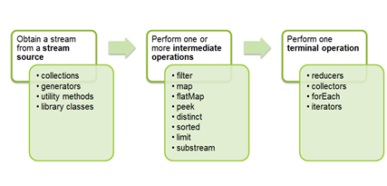
Using Streams
Steps:
Convert a collection to a stream
Process the elements possibly in parallel. The elements are processed by pipelining stream operations, i.e., zero or more so-called intermediate operations.
Gather the results (into a collection); use so-called a termination operation.

Slide 36
Example
List<Integer> numbers = Arrays.asList(1, 2, 3, 4, 5, 6, 7, 8, 9, 10);
List<Integer> evenSquares = numbers.stream()
.filter(n -> n % 2 == 0)
.map(n -> n * n)
.collect(Collectors.toList());
// Q: Parallelize it?
List<Integer> evenSquares = numbers.parallelStream()
.filter(n -> n % 2 == 0)
.map(n -> n * n)
.collect(Collectors.toList());

Slide 37
Stream Operations
Refer to Java.util.stream.Stream, IntStream, …
Operation | Description
boolean allMatch(Predicate<? super T> predicate) | Does every element satisfy the provided predicate?
boolean anyMatch(Predicate<? super T> predicate) | Does any element satisfy the provided predicate?
<R,A> R collect(Collector<? super T,A,R> collector) | Performs a mutable reduction on the elements using the provided collector.
long Stream<T> count() | Returns the number of elements.
Stream<T> distinct() | Returns a stream consisting of all distinct elements.
static <T> Stream<T> empty () | Returns an empty sequential stream.
Stream<T> filter(Predicate<? super T> predicate) | Returns a stream consisting of the elements that satisfy the given predicate.
void forEach(Consumer<? super T> action) | Performs a provided action on each element.
static <T> Stream<T> iterate(T seed, UnaryOperator<T> f) | Produces a stream consisting of seed, f(seed), f(f(seed)), etc.
<R> Stream<R> map(Function<? super T? extends R> mapper) | Returns a stream consisting of the results of applying the given mapper to the elements.
Optional<T> max(Comparator<? super T> comparator) | Returns the maximum element according to the provided comparator.
Optional<T> min(Comparator<? super T> comparator) | Returns the minimum element according to the provided comparator.
T reduce(BinaryOperator<T> accumulator) | Performs a reduction on the elements using the accumulator.

Slide 38
Exercise
Write the following methods using Java 8 stream operations. Hint: refer to the API doc of java.util.stream.Stream.
public class Board {
private final int size;
private final List<Disc> discs;
public boolean isFull() { … }
public Disc getDisc(int x, int y) { … }
}
Disc
+x: int {final}
+y: int {final}
-playerNumber: int
…

Slide 39
Answer
Disc
+x: int {final}
+y: int {final}
-playerNumber: int
…
public class Board {
private final List<Disc> discs;
public boolean isFull() {
}
public Square getSquare(int x, int y) {
return squares.stream().filter(s-> s.x == x && s.y == y).findFirst().get();
}
}

Slide 40
Outline
Collections
Collection interfaces
Collection classes
Iterators
Ordering
Streams (Java 8)
Input/output

Slide 41
Input/Output Stream
Two types of input/output
Stream I/O
Sequential reading and writing
Opened for reading or writing, but not both
Byte streams (8-bit) vs. character streams (16-bit Unicode)
Common Byte streams:
FileInputStream and FileOutputStream
Common Character streams:
FileReader and FileWriter
Random access I/O
Non-sequential reading and writing
Can be opened for both reading and writing
Notes:
sequence of data

Slide 42
Design of I/O Classes
Issue: Many enhancements or add-on features to basic byte-based I/O capability (InputStream and OutputStream)
Reading/writing primitive types, object types
Buffered read/write
Compression/decompression of data
Encryption/decryption of data
…
Solution?
One for each combination, e.g., BufferedFileDataInputStreamReader
Compositional, e.g, BufferedReader + InputStreamReader + DataInputStream + FileInputStream

Slide 43
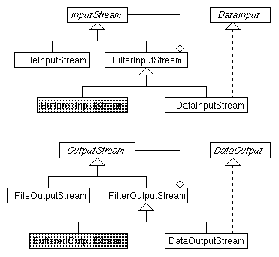
Byte Streams
Notes:
A Data input stream lets an application read primitive Java data types from an underlying input stream in a machine-independent way.

Slide 44
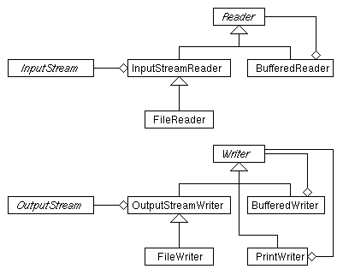
Character Streams

Slide 45
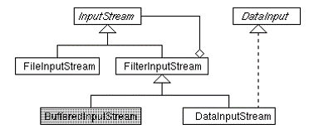
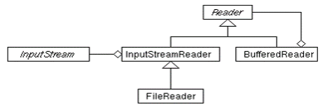
Example
Reading lines from file
String fileName = …;
BufferedReader reader = new BufferedReader(
new InputStreamReader(new FileInputStream(fileName)));
String line;
while ((line = reader.readLine()) != null) {
// do something with line …
}

Slide 46
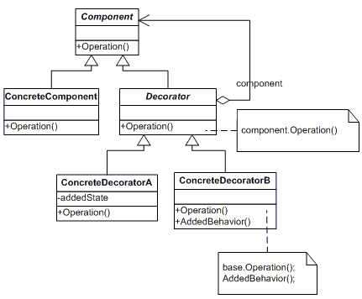
Decorator Pattern
To add additional responsibility or capability to an object dynamically

